Slide 1

SOWK 609B: School Social Work Practice and Policy
Session 1 Spring 2026
Binita M. Donohue, LCSW

Slide 2
Internship to date
Important events that have occurred
Crises/challenges that you have experienced
Skills you have acquired
Relationship with supervisor

Slide 3
As you begin this semester…
How are your background and identities defining your experiences and learning

Slide 4
Orientation, Disorientation and Reorientation
From your experience thus far, what has been keeping you oriented?
What feels disorienting?
How is all of this impacting you?
What do you see as the role of our classroom space?

Slide 5
FBA/BIP Assignment – quick bit of info
Part 1
1
Choose student
Write plan
Direct and indirect assessments
Record reviews
Part 2
2
Do your plan
Write up the FBA and BIP
Reflect on process
½ - 1 page
2 pages or 3-6 pages

Slide 6
Second Semester!
Special education – social work assessments and roles
SDS, FBA/BIP, Goals, MDR
Professional Development
Licenses
Burnout and self-care
Intervention in schools
Tiers 2 and 3
Clinical frameworks
School anxiety
Crisis Intervention

Slide 7

All issues
Throws a desk
Doesn’t attend school
Not doing homework
Failing grades
Special Education

Slide 8
Why is the student ”not learning?”
Able and willing
Able but unwilling
Willing but unable
Can’t and won’t

Slide 9
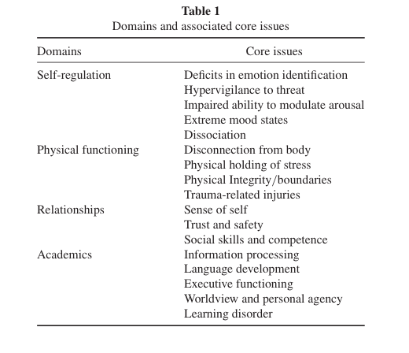
Tishelman, A. C., Haney, P., Greenwald O’Brien, J., & Blaustein, M. E.

Slide 10
Trauma and behavior
Trauma, behavioral responses and mental illness can coexist
Motivational factors can be controlled by a student
Mental health exists on a spectrum (ebbs and flows)
Traumatic responses are not in the control of a student

Slide 11
Process of Special Education Placement
Identify student
Problem solve
Monitor
Referral for sped
Domain meeting
Assess
Eligibility meeting
Placement is Decided
Create and Implement IEP
Pre-referral
60 School Days

Slide 12
Categories of Special Education
Autism
Deaf-blindness
Hearing Impaired
Developmental delay
Emotional Disability
Hearing Impairment
Intellectual Disability
Multiple Disabilities
Orthopedic Impairment
Other Health Impairment
Specific Learning Disability
Speech/language Impairment
Traumatic Brain Injury
Visual Impairment

Slide 13
Least Restrictive Environment
General Education
Resource
Instructional
General Education with accommodations and related service support
Push in
Co-taught
Pull out
Specialized Programs
Out of District Placement
Day School
Residential
Less restrictive
More Restrictive

Slide 14
Exclusionary Criteria for Special Education
Lack of appropriate instruction or attendance
English language proficiency
Temporary disabling issues
Economic disadvantage
Does not meet inclusionary criteria as determined by qualified professional

Slide 15
Domains
Health (Hearing/Vision)
Motor Abilities
Functional Performance
Cognitive Functioning
Social/Emotional Status
Academic Achievement
Communication Status

Slide 16
What happens at a Domain Meeting?
Team considers existing information about Child
01
Team determines if more information is needed
02
Decide how/who will get the additional data
03

Slide 17
The Team/The Process
At a domain meeting with a parent present, the LEA tells you that you will do a SDS for a child that you do not think needs to have one. The whole team is present. Practice what you would say.

Slide 18
Special Education Team
Team Member | Functions/Roles
District Rep/LEA | Leads meeting Connects to district services Represent the District
Parent/Guardian | Holds the child’s educational history Represents long-term goals Knows child
Regular Education Teacher | Relate child’s needs to general curriculum
Special Education Teacher | Recommend accommodations and/or modifications to curriculum Provide strategies for learning
Related Services Personnel | Evaluate domain area and interpret results of evaluation Recommend services as needed
Child | If 14+ - learn advocacy and rights

Slide 19
The Team/ The Process
Who on your team is your ally?
With whom would you expect to have some challenge?
What factors and dynamics contribute to your answer?

